Slide 1
Game Art 2 Van Helsing Low-fi
ALUNO: João Neto (a22200558)

Slide 2
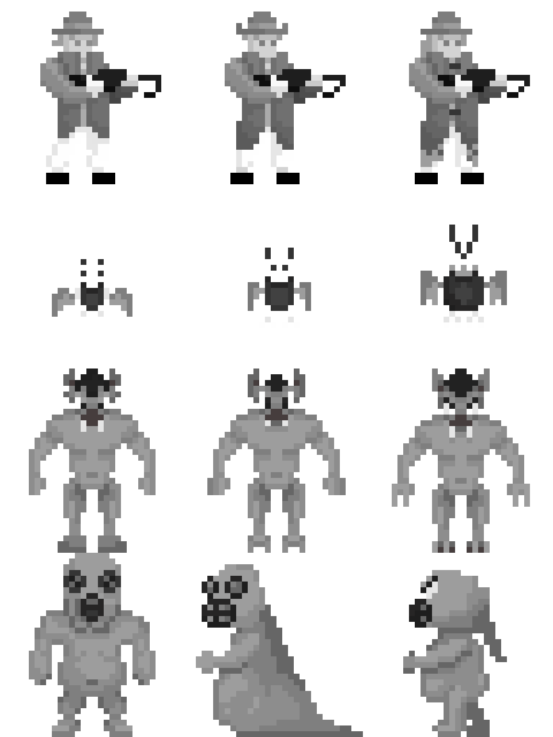
CHARACTERS

Slide 3
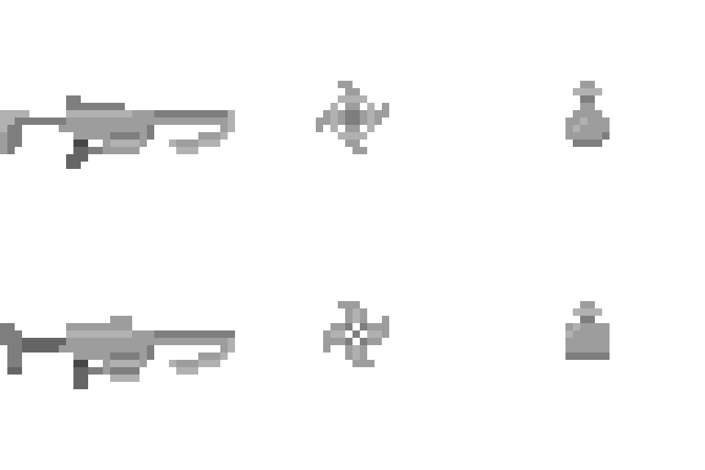
ASSETS

Slide 4
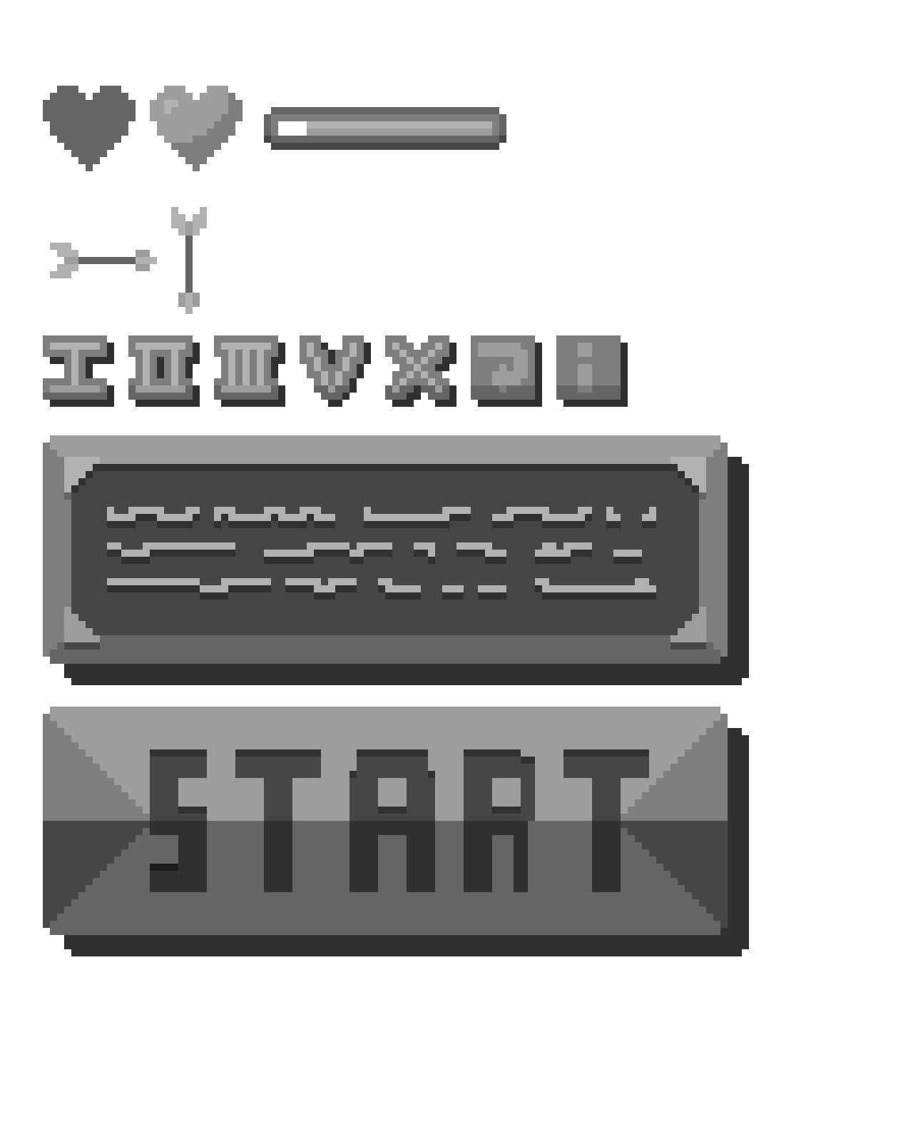
GUI

Slide 5
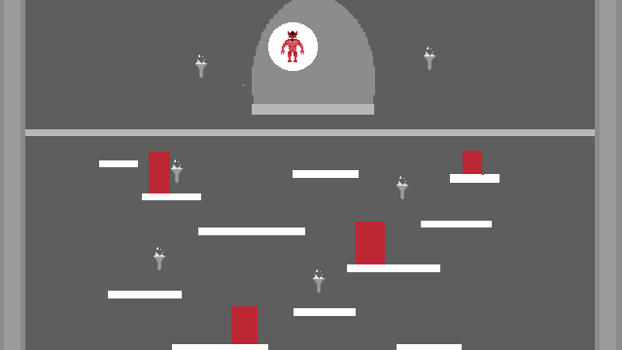
Dracula’s Castle Scenario

Slide 6

Forest Scenario

Slide 7

Mountains Scenario

